Slide 1
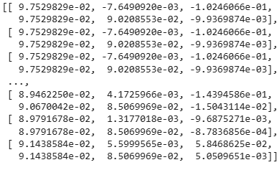
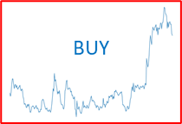
train.ipynb
Download historical data
Aggregates historical target stock prices + macroeconomic indicators: Oil, Gold, S&P, NASDAQ, Real Estate, Inflation expectations
Table processing
Image processing
Feature generation
Some 300 auto-generated features per asset. Including rolling lag, min, max, mean, std, diff, pct
Classify historical plots
Convert historical price data into rolling 1-year chart images.
Label each image according to future price behavior: BUY, KEEP, SELL
Feature selection
an XGBoost model ranks feature importance and selects top 20 most impactful features
Dataset with recommended features
Labled historical graphs
Train fastai model
Predict investment strategy per plot
Train models
LSTM, GRU, CNN , and combinations
Dataset with recommended features
Classified historical graphs
Best MM model
R2 ~= 97%
fastai model
R2 ~= 73%

Slide 2
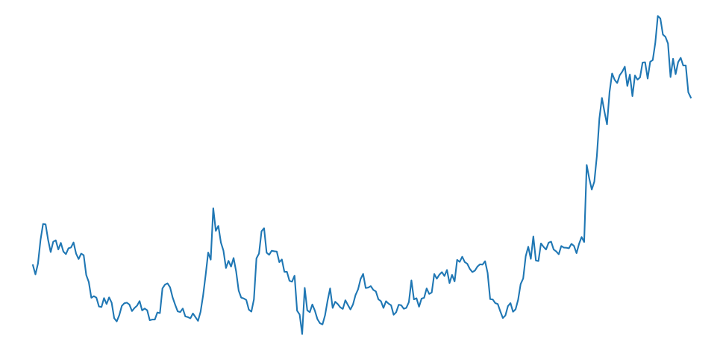
predict.ipynb
LLM API
Parses: natural language user prompts
Extracts: Target (ticker), Horizon(days)
[TKL days]
Download historical data for the TKL
End date = today
Table processing
Image processing
Reproduce top TS features
Those selected by the best model during train
Generate recent year’s plot
End date = today
Predict
Stock price
Predict
investment strategy
Best MM model
Best fastai model
Prediction of price, next few days
Investment strategy for next q: BUY, KEEP, SELL

Slide 3
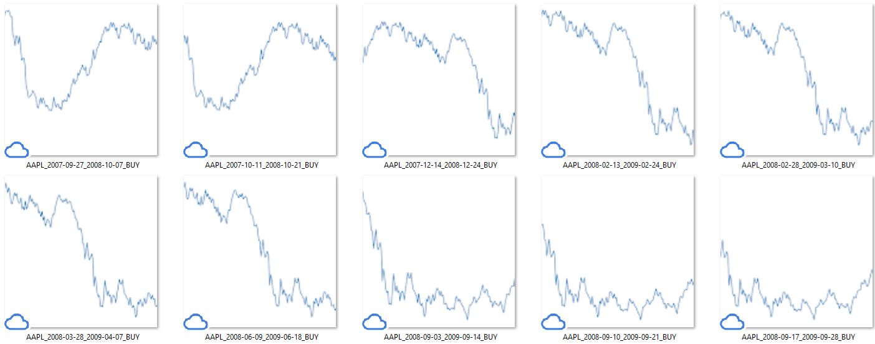
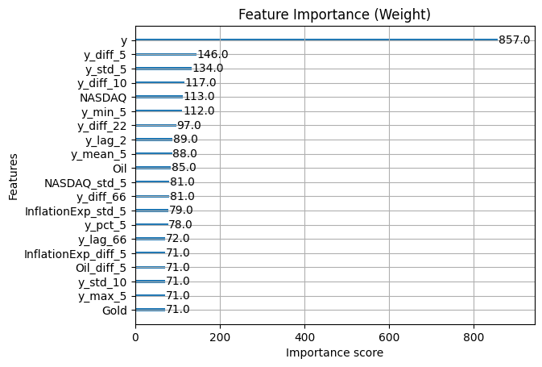
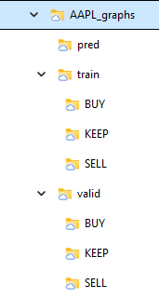
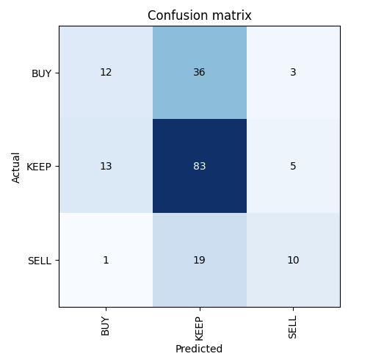
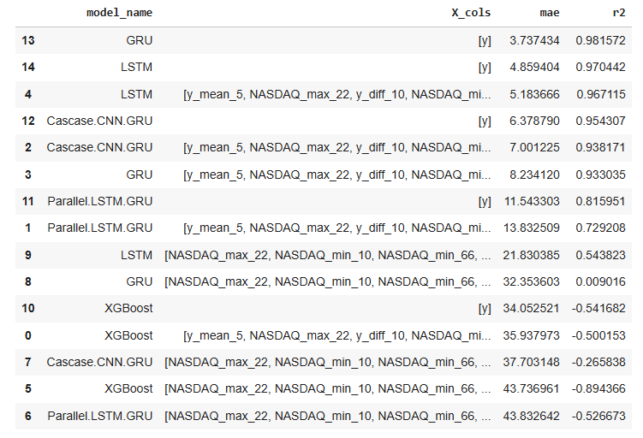
Train ‘AAPL’
Download historical data
Aggregates historical stock prices + macroeconomic indicators: Oil, Gold, S&P, NASDAQ, Real Estate, Inflation expectations
y
y_mean_5
y_diff_10
y_lag_2
y_diff_5
y_mean_10
y_min_22
y_min_5
y_diff_22
y_std_5
y_max_66
NASDAQ
NASDAQ_max_22
NASDAQ_min_10 NASDAQ_min_66
SP500_lag_5
Oil
Feature generation
Some 300 auto-generated features per asset. Including rolling lag, min, max, mean, std, diff, pct
Classify historical plots
Convert historical price data into rolling 1-year chart images.
Label each image according to future price behavior: BUY, KEEP, SELL
Feature selection
an XGBoost model ranks feature importance and selects top 20 most impactful features
Dataset with recommended features
Labled historical graphs
Train/Validate fastai model
Predict investment strategy per plot
Train models
LSTM, GRU, CNN , and combinations
Dataset with recommended features
Classified historical graphs
Best MM model
R2 ~= 97%
fastai model
R2 ~= 73%

Slide 4
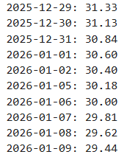
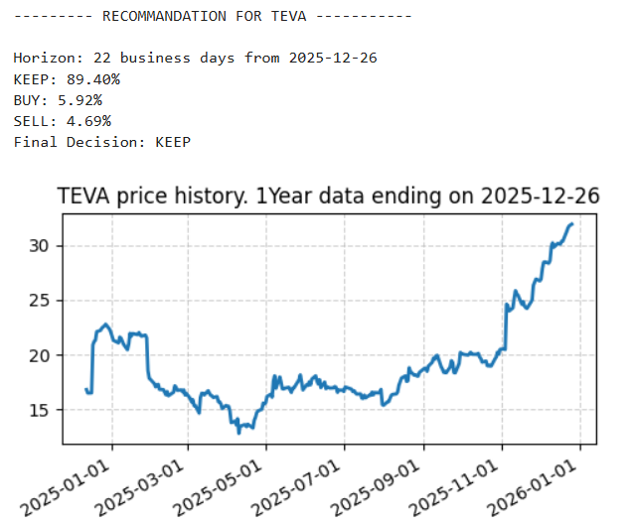
Predict ‘TEVA’
LLM API
Parses: natural language user prompts
Extracts: Target (ticker), Horizon(days)
[TKL days]
Download historical data for the TKL
End date = today
Reproduce top TS features
Those selected by the best model during train
Generate recent year’s plot
End date = today
Predict
Stock price
Predict
investment strategy
Best MM model
Best fastai model
Prediction of price, next few days
Investment strategy for next q: BUY, KEEP, SELL

Slide 5
Feature selection (by XGB)
AAPL features
y_mean_5, NASDAQ_max_22, y_diff_10, NASDAQ_min_10, y_min_5, NASDAQ_min_66, y_lag_2, y_diff_5, y_mean_10, y, y_min_22, Oil, y_diff_22, y_std_5, NASDAQ, y_max_66, SP500_lag_5
INTC features
y_min_5, SP500_max_22, RealEstate_min_66, Gold_std_5, y, NASDAQ, y_max_10, y_max_5, y_diff_10, Oil, y_mean_5, Oil_std_5, y_diff_5, y_std_5
NSFT features
InflationExp, y_diff_66, Oil, y_diff_22, y_min_22, NASDAQ, y_max_5, y_diff_10, y_lag_5, y_std_5, NASDAQ_min_22, NASDAQ_min_10, SP500_max_22, y, y_min_5, y_max_10, y_diff_5
NVDA features
y_diff_5, y, Oil, SP500_lag_4, y_lag_2, SP500_max_5, InflationExp, y_max_66, y_min_10, y_min_5, NASDAQ, y_lag_5, Gold_min_22, y_diff_22, SP500_min_10, y_max_10, y_diff_66, y_max_5
TEVA features
y_lag_2, y_min_10, SP500_std_10, y_std_5, NASDAQ, y_min_5, y_mean_5, Oil, InflationExp_std_5, y_diff_5, y_diff_10, y, y_pct_5

Slide 6
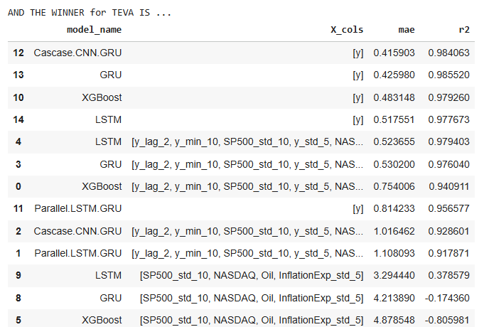
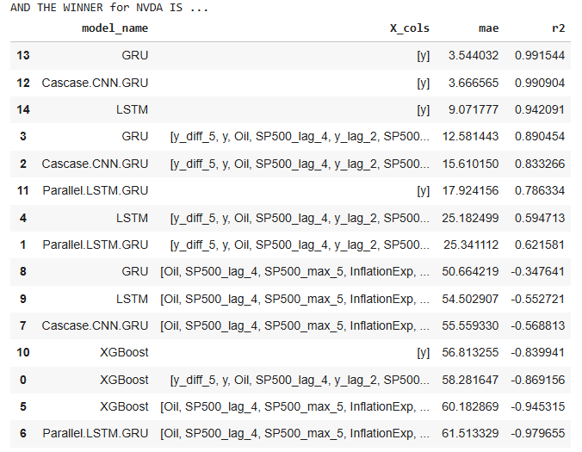
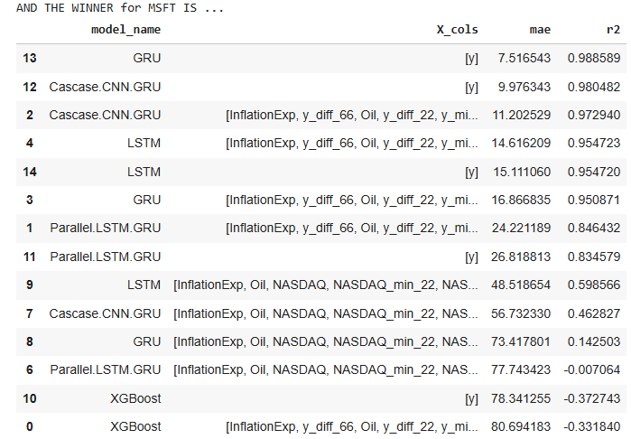
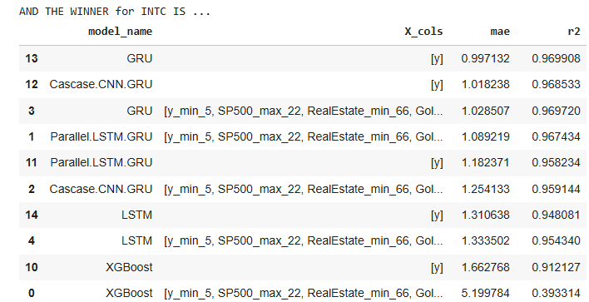
Model selection
Key take away:
R2 is very high
The ticker is the best feature to predict the ticker
GRU is best for this job

Slide 7
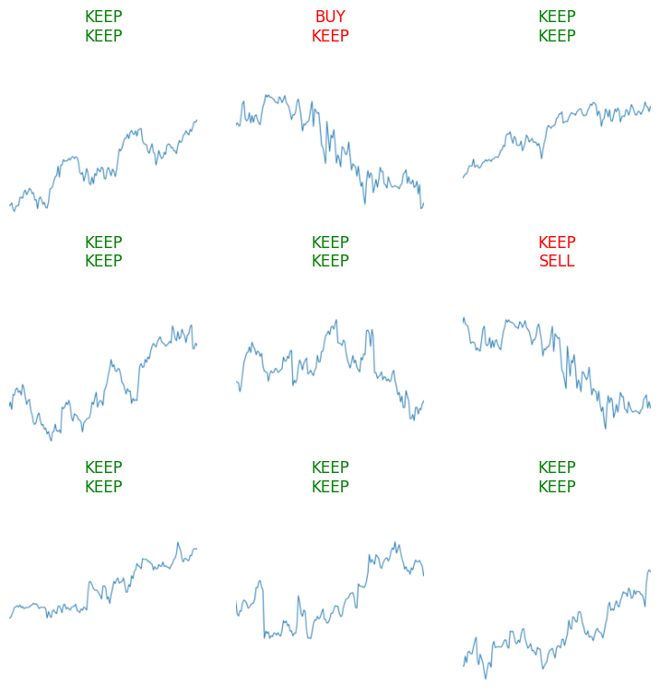
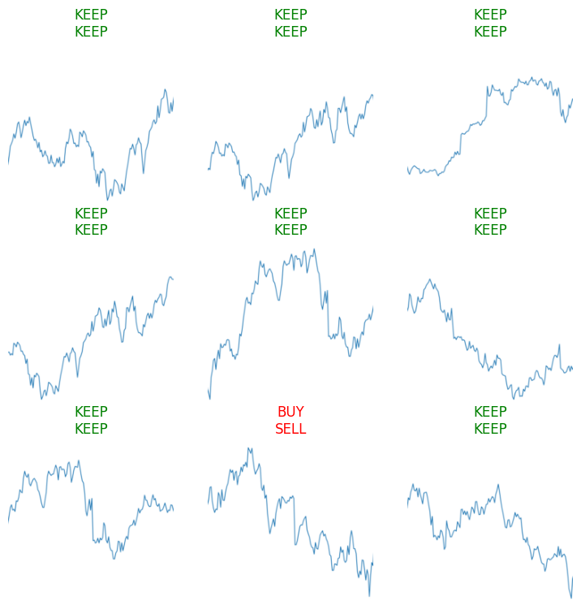
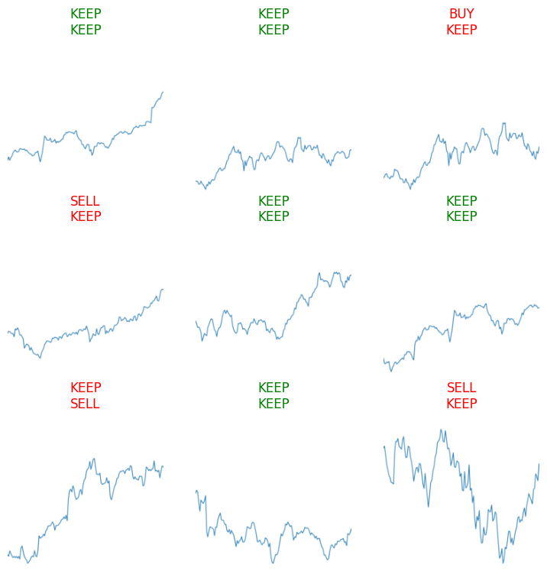
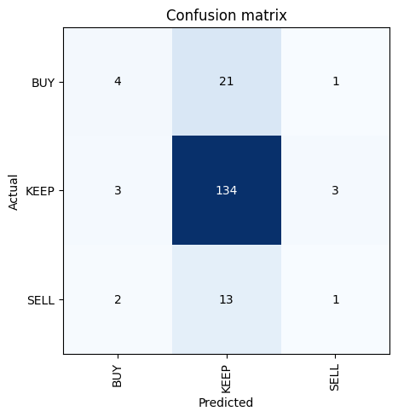
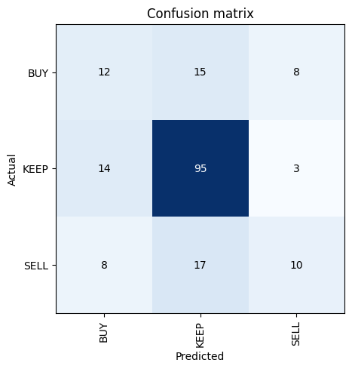
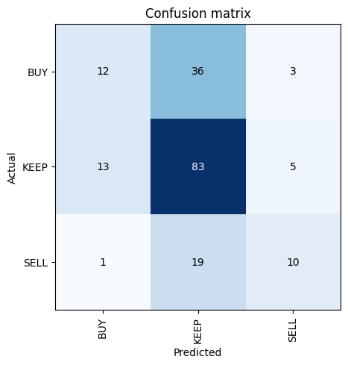
Fastai
classification
MSFT
INTC
AAPL

Slide 8
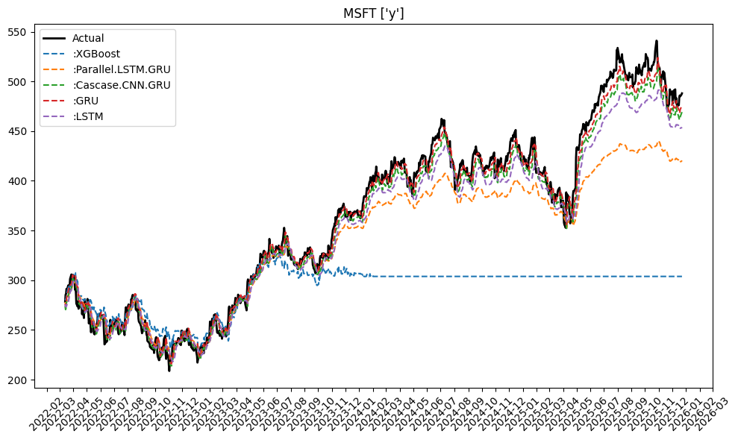
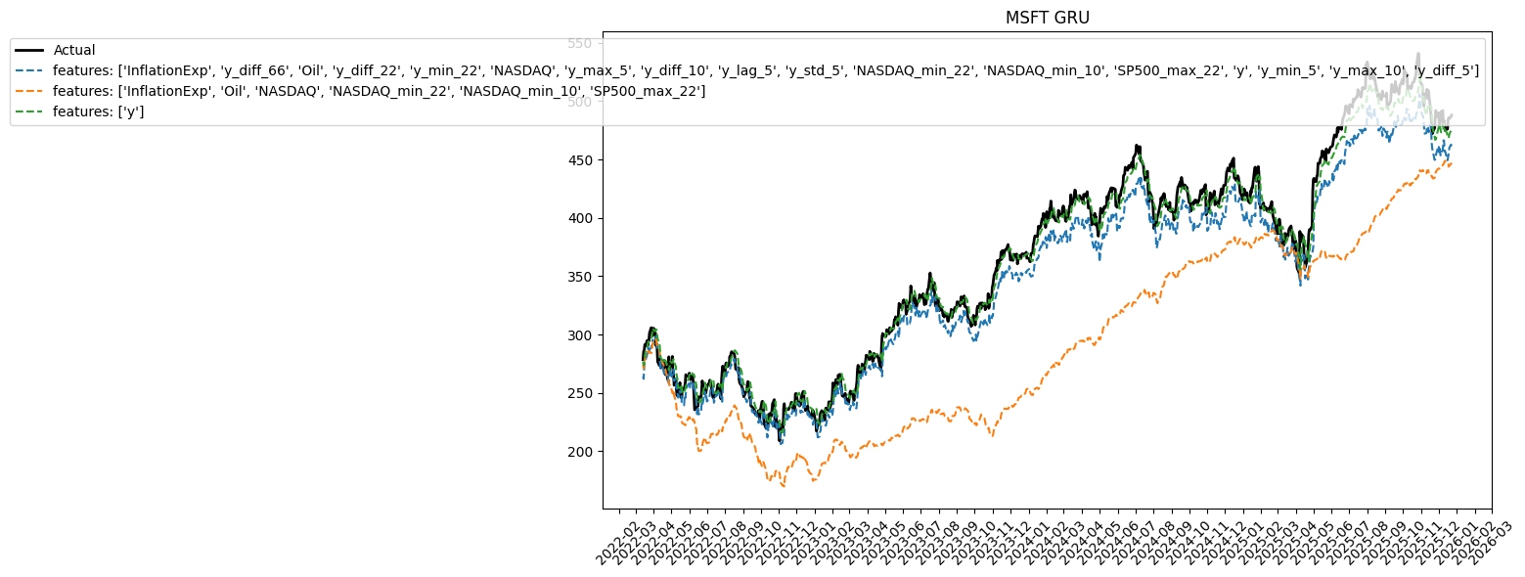
MSFT

Slide 9
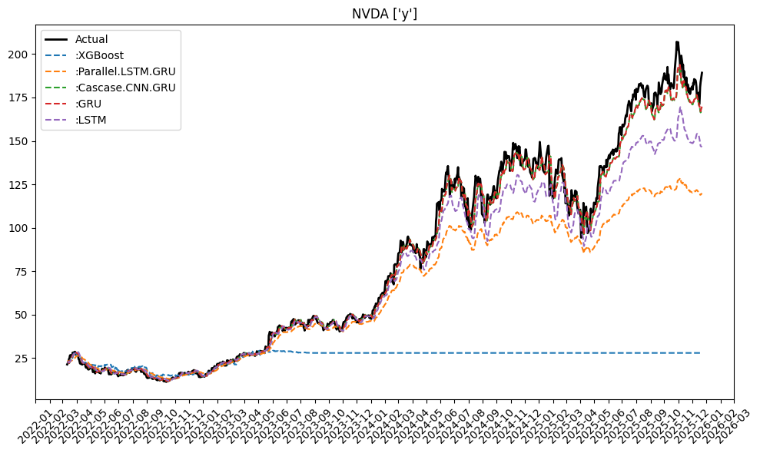
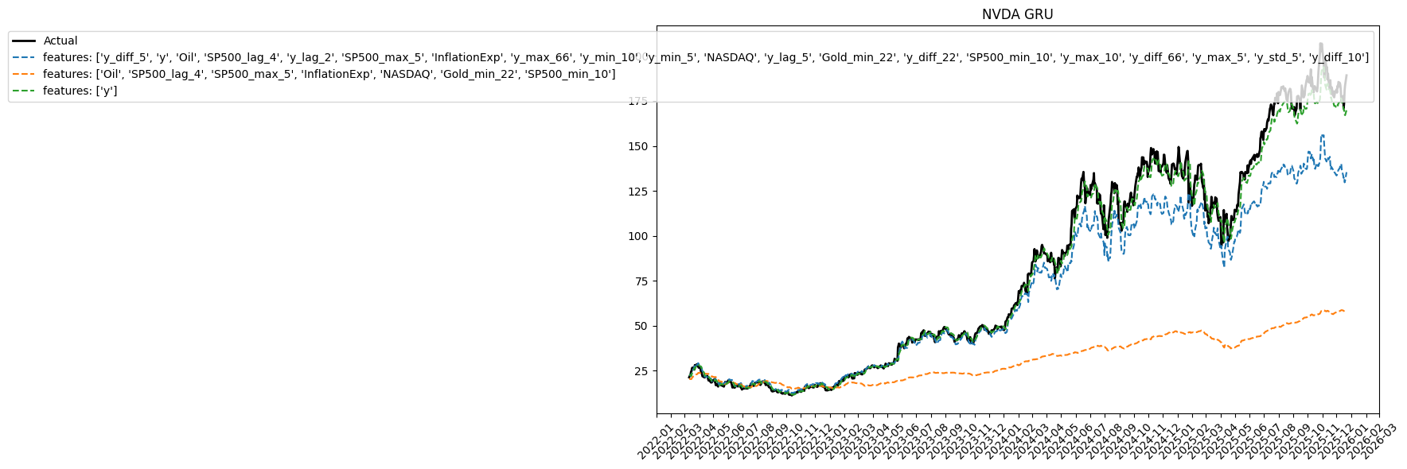
NVDA

Slide 10
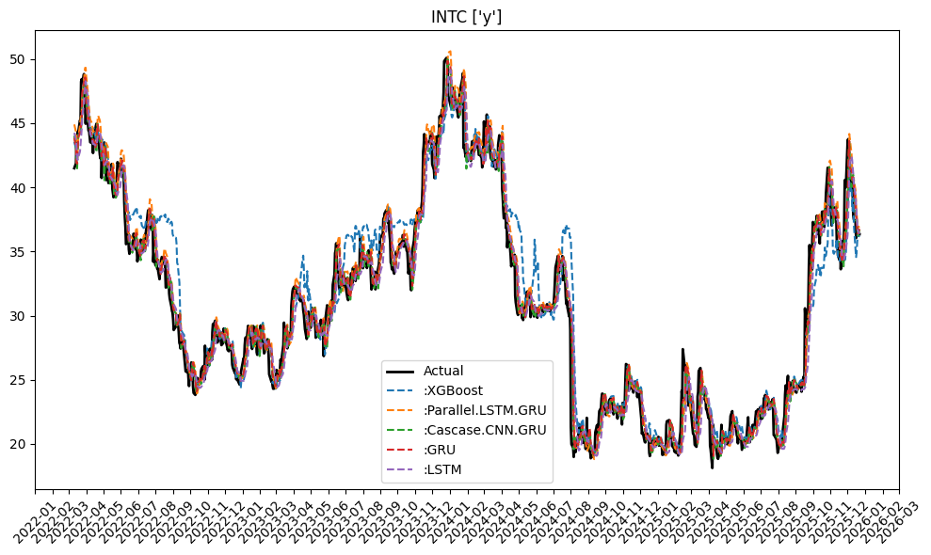
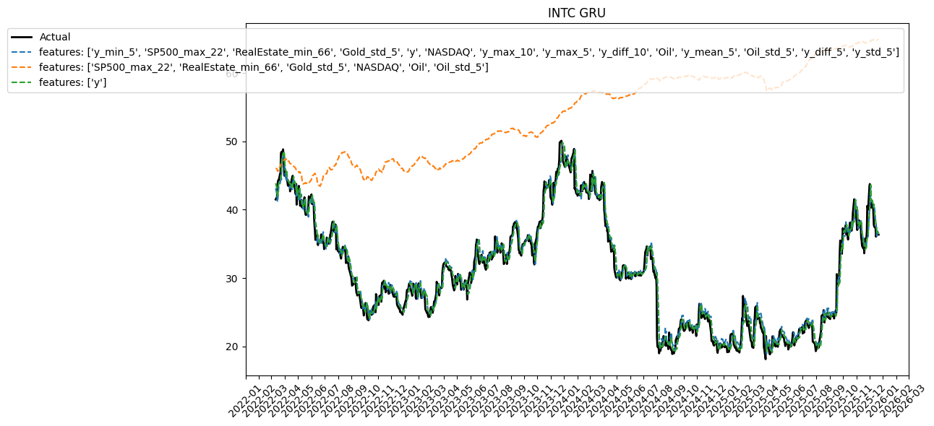
INTC

